Slide 1
Distributed Software Architecture
SE495: Software and Systems Integration

Slide 2
Outline
Architectures
CORBA
Classifying Distributed Systems
Distributed Development

Slide 3
Architectures

Slide 4
Enterprise Systems:
Perform enterprise activities
Management
and Support
Application Systems:
support enterprise systems
Interoperability
Distributed Computing Platform
Application Support Services (OS,
DB support, Directories, RPC)
Communication Network Services
(Network protocols, Physical devices)
Hardware
Portability
Integration
Network
Management
4

Slide 5
Enterprise Systems:
Engineering systems
Business systems
Manufacturing
Office systems
Management
and Support
Interoperability
Application Systems:
User
Interfaces
Processing
programs
Data files &
Databases
Portability
Distributed Computing Platform
Application Support Services
Integration
C/S Support
Dist. Data
Trans. Mgmt.
Distributed
OS
Network
Management
Common Network Services
Network protocols & interconnectivity
OSI
protocols
TCP/IP
5

Slide 6
Client-Server (Two-Tier) Architectures
The application is modelled as a set of services that are provided by servers and a set of clients that use these services;
Clients know of servers but servers need not to know of clients;
Clients and servers are logical processes: They could reside/running on different processors or on the same processor;
The mapping of processors to processes is not necessarily one to one.

Slide 7
Client-Server Systems and their Federation
Server
Virtualization of services
Virtual server A
Server
2
Server
1
Multi tenancy / Loadbalancer
database
Cloud Computing
Federation
A server also manages the database
Virtualization of services
Virtual server B
Server
3
Server
4
Multi tenancy / Loadbalancer

Slide 8
Thin-Client and Fat-Client Architectures
Thin-client architecture
All of the application processing and data management are carried out on the server.
The client is simply responsible for running the presentation/GUI software.
Fat-client (Thick-client) architecture
The software on the client implements the application logic and the interactions with the users.
The server is responsible for data management (database) only.
Example: Many game programs, Adobe Flash and MS Silverlight support Fat Clients, HTML5 can also support Fat Clients, where intensive processing and responsiveness are required.

Slide 9
Traditional Three-Tier Architecture
Each layer may execute on a separate processor;
A more balanced approach, which allows for better performance than a thin-client approach and is simpler to manage than a fat-client approach;
A more scalable architecture - as demands increase, extra servers can be added.
Presentation
Layer (GUI)
Application
Processing Layer
Data Management
Layer

Slide 10
Example: A 3-Tier Internet Banking System
Client
Client
Client
HTTP
HTTPS
Web Server
for account
service
provision
Data Management Layer
Client
Database server
Customer
account
database
Presentation Layer
in Client Browsers
Business Logic Layer
in server
Database requests and responses

Slide 11
Four-Tier Architecture with a Service Layer
Each layer may execute on a separate processor;
Application is largely composed of existing services, running on a different server (repository), provided by external service providers;
This is an example of Service-Oriented Architecture (SOA);
SOA does not have to be in N-Tier. It can be a tree or graph too.
Presentation
Layer (GUI)
Not accessible outside
Application
Processing Layer
In-App Data
Management
Service Repository
Layer
Data
Management
Data Management
Layer outside App
Shared by many applications

Slide 12
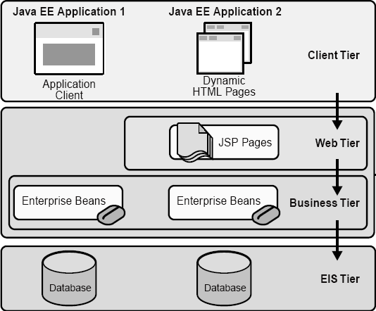
Four-Tier Architecture: Java EE Application Source: Java Enterprise Edition
Client Machine
Java EE Server
Enterprise
Information
System
EIS Database
Server

Slide 13
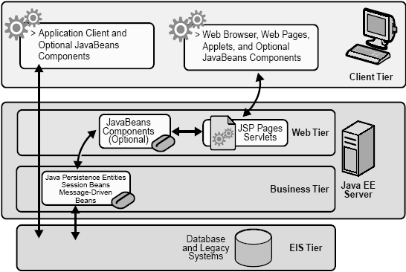
Java EE Application (not strictly tiered)
Thick client
Thin client

Slide 14
Various Middlewares…
DCE,CORBA, OMG, CanCORBA, ORBIX, JavaORB, ORBLite, TAO, Zen, RTCORBA, FTCORBA,DCOM, POA,IDL,IOP,IIOP, ObjectBroker, Visibroker, Orbix, ObjectBus,ESBs
MOM – TIBCO TIB/Rendezvous, BEA MessageQ, Microsoft MSMQ, ActiveWorks
JVM, JINI, RMI, J2EE, EJB,J2ME, JDBC,JTA, JTS,JMS, JNDI,
Enterprise Middleware Technologies -- BEA WebLogic, IBM WebSphere, TivoliBeans
ENCINA, Tuxedo, CICS
SOAP, Web Services, WSDL, BPEL
XML, XQuery, XPath, JSON, MQTT, CoAP
Hadoop, MapReduce, VM, IaaS, PaaS, NaaS, DAS,
14

Slide 15
Types of Middleware
Message-Oriented Middleware (MOM)
Object Middleware
Remote Procedure Call (RPC) Middleware
Database Middleware
Transaction Middleware
Portals
Embedded Middleware
Content-centric Middleware

Slide 16
Types of Middleware
Message-Oriented Middleware (MOM)
This type of middleware is an infrastructure that supports the receiving and sending of messages over distributed applications.
It enables applications to be disbursed over various platforms and makes the process of creating software applications spanning many operating systems and network protocols much less complicated.
It holds many advantages over middleware alternatives (e.g. hard coding logic) and is one of the most widely used types of middleware.
Object Middleware
Object middleware, also called an object request broker, gives applications the ability to send objects and request services via an object oriented system.
In short, it manages the communication between objects.

Slide 17
Types of Middleware
Remote Procedure Call (RPC) Middleware
An RPC is exactly what it sounds like.
It calls procedures on remote systems and is used to perform synchronous or asynchronous interactions between applications or systems.
It is usually utilized within a software application.
Database Middleware
This type of middleware allows for direct access to databases, providing direct interaction with them.
There are many database gateways and connectivity options. You simply have to see what will work best for your necessary solution.
This is the most general and commonly known type of middleware. This includes SQL database software.

Slide 18
Types of Middleware
Transaction Middleware
This type of middleware includes applications like transaction processing monitors. It also encompasses web-application servers.
These types of middleware are becoming more and more common today.
Portals
This refers to enterprise portal servers.
It is considered middleware because portals facilitate front-end integration.
They are used to create interactions between a user’s computer or device and back-end systems and services.

Slide 19
Types of Middleware
Embedded Middleware
This type of middleware allows for communication and integration services with an interface of software or firmware.
It acts as a liaison between embedded applications and the real-time operating system.
Content-centric Middleware
This type of middleware allows you to abstract specific content without worrying how it is obtained.
This is done through a simple provide / consume abstraction.
It is similar to publish / subscribe middleware, which is another type of this software that is often used as a part of web-based applications.

Slide 20
Distributed Object Architecture
In distributed object architecture:
There is no distinction between clients and servers
Each distributable component is an object that provides services to other objects and receives services from other objects
Object communication is through a middleware system called an object request broker (ORB, also called software bus)
However, more complex to design than client-server systems
No explicit separation of duties – The same person/team designs the same types of objects and the entire system, which requires complex skill to handle.
There are competing standards.

Slide 21
Distributed Object Architecture Example
Objects
ORB / Software Bus
Objects

Slide 22
Advantages of Distributed Object Architecture
It is an open system architecture that allows new resources to be added to it as required;
The system is flexible and scalable;
It is possible (e.g., written in the same language) to reconfigure the system dynamically with objects migrating across the network as required.
It allows the system designer to delay decisions on where and how services should be provided;

Slide 23
Uses of Distributed Object Architecture
As a logical model that allows you to structure and organize the system. In this case, you think about how to provide application functionality solely in terms of services and combinations of services;
As a more flexible approach to the implementation of client-server systems. The logical model of the system is a client-server model, but both clients and servers are realized as distributed objects communicating through an ORB /software bus.

Slide 24
CORBA

Slide 25
CORBA: Common Object Request Broker Architecture
Defined by the Object Management Group (OMG)
An international standard for an Object Request Broker - middleware to manage communications between distributed objects/components
Enable software components written in multiple computer languages and running on multiple computers to interoperate;
Several implementations of CORBA are available;
DCOM was an alternative (competing) approach by Microsoft to object request brokers.

Slide 26
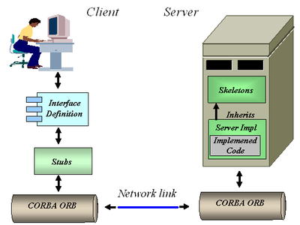
CORBA
CORBA objects are comparable, in principle, to objects in C++ and Java;
The objects have a separate interface defined by the Interface Definition Language (IDL) that is similar to C++;
There is a mapping from this IDL to programming languages (C++, Java, etc.);
Therefore, objects written in different languages can communicate with each other;
CORBA can be used for implementing a Client-Server Architecture →

Slide 27
Object Request Broker (ORB)
Publish / register
The ORB handles object communications.
A service provider makes its services known via stubs.
Agent / broker
Using an ORB, the calling object binds an IDL stub that defines the interface of the called object.
Calling this stub results in a call to the ORB, which then calls the required object through a published IDL skeleton that links the interface to the service implementation.

Slide 28
ORB-based Object Communication
Distributed Object Architecture: Objects can use each other’s services.
IDL
Stub
IDL
Stub
IDL
Stub
IDL
Stub
Object Request Broker
Object Request Broker
Network

Slide 29
MS DCOM: Distributed Component Object Model
Originally, Microsoft distributed object system was called OLE (Object Linking and Embedding) and then “Network OLE”;
It was extended to Microsoft's COM (Component Object Model) in 1993, which provided the communication capacity among objects;
Windows 2000 significantly extended COM and renamed it COM+. Then, COM+ becomes DCOM later;
DCOM allows software components to distribute across several networked computers to communicate with each other;
All these technologies are integrated into and replaced by Visual Studio .NET, which supports both Object-Oriented and Service-Oriented Architecture (SOA).

Slide 30
Classifying Distributed Systems

Slide 31
Classifying Distributed Systems
Based on Architectural Models
Client-Server, Peer-to-peer, Proxy based,…
Based on computation/communication - degree of synchrony
Synchronous, Asynchronous
Based on communication style
Message Passing, Shared Memory
Based on Fault model
Crash failures, Omission failures, Byzantine failures
how to handle failure of processes/channels
31

Slide 32
Enterprise Service Bus (ESB)

Slide 33
Enterprise Service Bus (ESB)
Shifting from Distributed Object Orientation to Service Orientation
An ESB provides an abstraction layer on top of an implementation of an enterprise messaging system;
It allows integration architects to exploit the value of messaging without writing code.
It is the service-oriented version of ORB.
Contrary to the more classical Enterprise Application Integration (EAI) approach (tightly coupled), ESB provides a loosely coupled platform to support distributed functions, with distributed (independent) deployment where needed, while still working in harmony.

Slide 34
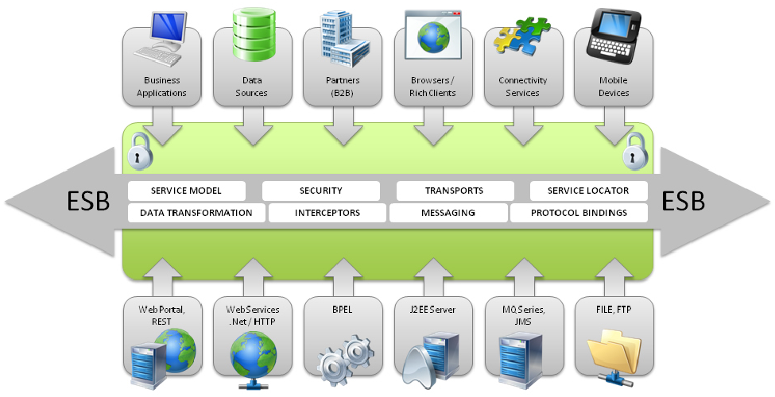
Enterprise Service Bus (ESB)
An enterprise service bus (ESB) implements a communication system between mutually interacting software applications in a service-oriented architecture (SOA).
ESB promotes agility and flexibility with regard to high-level protocol communication between applications.
Its primary use is in enterprise application integration (EAI) of heterogeneous and complex service landscapes.

Slide 35
Modeling Business in SOA
Turn this model …
…into this (SOA).
Depository
Vendor Setup
Vendor
Process Servers
Banks
Customer Perceived
Application
Service
Application
Service
Application
Service
Application
Service
Budget
Maintenance
(Imaging)
NEW Soundscan
Shows
VAN
Universal Account
In-Stock
Analysis Tool
Printer
S20-Sales
Mesa Data
Reconcilliation
Maintenance
Polling
I13- Auto
Hand Scan
Printer PO
Customer
Replenishment
Apps
Reports
Insertions
Sales
Order
Due Dates
Calendar
Orders
Print Costing
Corrections
Warehouse
Broadcast
General
Invoice App
Management
Stores & Mrkts
Filter
Maintenance
Interface
PO
Smart Plus
Millennuim 3.0
Smart Plus
Sales Posting
Launcher
Cell
Return to
Tally Sheet
Millennium
Phones
D01 Post Load
Vendor
Credit App
Stock Options
Employee
Equifax
Billing
Solution
Satellite
Resource
Change Notice
A04 - Cust
Software
System
-Promo
Scheduling
On-line New
Refund Chks
DFK
1
Analysis
Interface
Interface
Interface
Resumix
Hire Entry
P01-
AAS
Price
Employee
Marketing
Cobra
P09 - P17
Masterfile
Support
Bus Systems
Cyb.
ABC
website
- ISP
CTS
Co
Home
Cycle Physical
Tracking
ACH
Prodigy
V04-Sign
Deliveries
Inventory
Banks - ACH and Pos to
POS
System
CTO
-
Pay
Transfers
Host to AS400
Plan Administrators
Communication
(401K, PCS, Life)
Spec Source
Stock
SKU Tracking
Status
Counts
Price
Testing
Supplier
Employee
Intercept
Sales
Scanning
Layaways
Compliance
Purchase
Tax
Spec
PO
Scorecard
Source
Receiving
SKU
Mkt
Performance
Bonus/HR
Reactions
Polling
Price Management
Inventory Info
Coop
SKU Selection
DRK
System
Customer Repair
Tool
ABBX
Tracking
I35 Early Warning
Planning
Rebate
SKU Rep
System
Store
Transfer
SKU
Purchase
Monitor
PowerSuite
General
Information
Order
Ad Expense
Ledger
Store
Tex A
Sign
Scorecard
System
N.
Count Corrections
Store Budget
Interface
Interface
Interface
Interface
Tx
Writer
Merchandise
Media
Reporting
Workspace
Analysis
BMP - Bus
EDI
performance Mngt
Mngr Approval
Coordinator
Batch Forcasting
AIMS
AP
Journal Entry Tool Kit
Ad Measurement
Cellular
INVENTORY CONTROL APPS - PC
INVENTORY CONTROL APPS - PC
ACCTS REC APPS - PC
Ad
AIMS
Rollover
OTHER APPS - PC
Launcher
Reporting
House
PSP
Capital
Op.
Recon
File
Charges
Data Warehouse
In-Home
Projects
SS
Connect 3
Credit
Repair
Connect 3
Connect 3
Cash Receipts/Credit
Application
Service
Application
Service
Application
Service
Application
Service
Fixed
PDF Transfe
Reports
Misc Accounting/Finance Apps - PC/NT
Warranty
Assets
Billing
Repair
Cash Over/
System
Short
Rich business abstractions describe the application interface
Decouples the interfaces from the business applications
The number and complexity of the interfaces are reduced
Business applications and their interfaces become reusable
Notes:
So how does web services decouple the interfaces from their applications?
1) It uses a programming model that allows a rich abstraction of both the business app and the interface.
2) By abstracting the interfaces, they can be clearly separated from the business applications.
3) This enables you to reduce the number and complexity of those interfaces and.
4) It allows you to reuse both the interfaces and the business applications.
The problem is that you still have to build, find, and manage all of those interfaces somewhere.

Slide 36
The ESB shrinks those interfaces further
Turn this (web services)…
…into this (SOA)
Application
Service
Application
Service
Application
Service
Application
Service
Application
Service
Application
Service
Application
Service
Application
Service
Interface
Interface
Interface
Enterprise Service Bus
Interface
Interface
Interface
Interface
Application
Service
Application
Service
Application
Service
Application
Service
Application
Service
Application
Service
Application
Service
Application
Service
Decouples the point-to-point connections from the interfaces
Allows for dynamic selection, substitution, and matching
Enables more flexible coupling and decoupling of the applications
Enables you to find both the applications and the interfaces for re-use
Notes:
The ESB shrinks the interfaces further.
1) It virtualizes the interface, or in other words, it decouples the point-to-point connections from the interfaces themselves.
2) The interfaces are put into a third party broker which helps you manage the interfaces better.
3) The enables faster and more flexible coupling and decoupling of applications.
4) Because you can find all of the applications and the interfaces, you can then reuse both.

Slide 37
Distributed Development

Slide 38
Distributed Development: Separation of Responsibility
The Three-Party Model of Service-Oriented Software Development
Not a part of the model
Developers who understand database, ontology, searching, and matching
End user
White pages
Yellow pages
Traditional object-oriented programmers, active objects hosting
Software engineers who understand the application domain
Service brokers
Green pages
Registry
Registry
Service repository
Internet
Application builders
Service providers
Applications
Active Objects
Service requesters
Service developers

Slide 39
A Scenario of the SO Software Development and Tools
Programming
languages:
C++, C#
Java, Python
Directory of services
UDDI / WSDL / SOAP
ebXML, RDF/S, OWL
Ontology
(3) Registering
Service
Development Envir:
Visual Studio, Flask, Django
Java EE / Eclipse / NetBeans
Service brokers
Registry
Registry
(5) Found
(2) Publishing
Internet
(4) Finding
Application builder
Service providers
(6) Binding
(7) SOAP/HTTP call
(1) Developing
Applications
Active Objects
(8) Results
Application development platforms
Specification languages VS, WebSphere, SCA/SDO, WF, WSFL, BPEL, Django for composition, code generation, in addition to use programming languages
Using Web Service standards:
XML, WSDL, RDF, OWL, ontology

Slide 40
Web Services in Web Applications
Brokers
Application builders
Service Directory
UDDI or ebXML
Other Web
Services
Service
requesters
SOAP/HTTP
Global Data
WSDL Interface
Local Data
Service / Object
Database and Ontology
IDE (.Net or Java EE)
Big Data
Programming languages
Data Infrastructure
Web Services
Service hosting infrastructure, e.g., servers or cloud computing
A program consists of algorithms and data

Slide 41
Definitions and Terminologies
A service is the interface between the producer and the consumer.
From the service provider's point of view, a service is a function module that is well-defined, self-contained, and does not depend on the context or state of other functions. A service is often implemented by an active object.
Services can be newly developed modules or just wrapped around existing (legacy) software to give them new interfaces.
From the application builder's point of view, a service is a unit of work done by a service provider to achieve desired end results for a service consumer (an application builder, not an end user).
A service normally does not have the human user's interface. Instead, it provides loosely coupled Application Programming Interface (API), with standard interface, so that a service can be discovered and invoked by a computer program.
For human users (end users) to use services, a (graphic) user interface needs to be added – forming a (Web) application.

Slide 42
Definitions and Terminologies (contd.)
Service-Oriented Architecture (SOA): Software consisting of a collection of loosely coupled and platform-independent services that communicate with each other through standard interfaces. SOA does not concern developing operational software.
Service-Oriented Computing (SOC) refers to the paradigm that represents computation in SOA. A level deeper than SOA, incl. algorithms and data structures.
SOA and SOC are often used interchangeably.
Web Services are services accessible over the Web. As an architecture, it refers to Web-based SOA and a set of enabling Web technologies, including XML, JSON, SOAP, WSDL, HTTP, UDDI, and ebXML. Two types of Web services:
SOAP/WSDL Services (heavy duty services)
RESTful Services (lightweight or micro services)

Slide 43
Definitions and Terminologies (contd.)
Service-Oriented Development (SOD)
concerns the entire software development cycle based on SOA concepts and SOC paradigm.
involves current technologies and tools to effectively produce operational software:
Development environments: VS, Java EE, Flask, Django, NetBeans, WebSphere, etc.;
Databases, SQL, Oracle, BD, XML DB, etc.;
Deployment and hosting environment: Server, cloud: SoD, AWS Cloud, Google Cloud, MS Azure, etc.

Slide 44
OO Development versus SO Development
SO Protocols/
Languages
SO Concepts
SO IDEs/Tools
SO Development Cycles
Service
orientation
Loosely
coupled
Remote binding
Dynamic composition
Standard interfaces
XML
WSDL
SOAP
RDF
OWL
BPEL
SCA/SDO
PSML
Visual Studio
Flask, Django NetBeans
Oracle SOA suite
JDeveloper
Java EE
WebSphere
ebXML
Service development in OOC
Interface definition / wrapping
Service hosting / registration
Application specification
Service search
Remote binding
Operation
Dynamic configuration
Directory
Repository
Ontology
Match
OO Concepts
OO Languages
OO IDEs/Tools
OO Development Cycle
Object
orientation
Inheritance
Polymorphism
Dynamic
binding
C++
C#
Objective C
Java
Python
Smalltalk
CORBA
Eclipse
UML
GCC
Visual Studio
Specification/Modeling
Verification/Model checking
Design / Coding
Validation / Testing
Operation
Maintenance

Slide 45
Component-Based Development
Bricks and Tiles
Traditional
Component-based

Slide 46
Component-Based Software Development
Organization X:
Component library
Organization Y:
Component library

Slide 47
Service-Oriented Software Development
Design Pattern?
Application
proxy
proxy
proxy
proxy
proxy
Auto-searchable
Found
Standard
Interface
Service broker
Registration
Organization X:
Component library
Organization Y:
Component library
Organization Z:
Component library

Slide 48
XML
XML (Extensible Markup Language) is a Meta language :
Used for defining other languages. Most languages and protocols in SOC paradigm are based on XML
BPEL (Business Process Execution Language)
RDF, RDF Schema, and OWL
SOAP
WSDL
UDDI
Similar to html to some extent, but you can define your own tags to quote data
You can define attributes to each data item for semantic meanings. Data transferred between Web services are often encoded in XML

Slide 49
HTML versus XML
<html>
<h1>International Conference on Software Engineering and applications, November 14-16, 2005, Phoenix, AZ, USA</h1>
<li>Software design and development</li>
<li>Software engineering applications</li>
<li>Software security</li>
</ br>
</html>
<?xml version="1.0">
<conference>
<title>International Conference on Software Engineering and applications</title>
<date>November 14-16, 2005</date>
<location>Phoenix , AZ, USA </location>
<keyword>Software design and development</keyword>
<keyword>Software engineering applications</keyword>
<keyword>Software security</keyword>
</conference>

Slide 50
Differences between HTML and XML languages
 | HTML | XML
Purpose of tags | Formatting data for display. | Define tags and attributes on data that can be interpreted by human and machine.
Syntax of tags | Tags may be left open, e.g., <li>, <br>. | All tags must be in pair, e.g., <li> </li>, <br> </br>
Semantics of tags | Tags are predefined with given format meaning. Tags are limited. | The user can choose any tags and the meanings can be defined separately. Assigning meanings to a set of tags defines a vocabulary and thus a new markup language.
Schema | The schema is fix and implied | Need a schema file to define the tags and the structure
Semantics of data | It is difficult for machine to understand. For example, is “Phoenix” a part of the title? | Once the tags are defined, it is easy for the machine to understand. “Phoenix” is a location, not a part of the title.

Slide 51
SOAP: Simple Object Access Protocol
SOAP is used for transporting messages between Web services and applications
A SOAP message is an XML document
Like any communication protocol, a SOAP message consists of wrapper information and payload;
The format of SOAP message is as follows:
A SOAP message is often wrapped in an HTTP (Hypertext Transfer Protocol ) message and sent as an HTTP packet over the internet:
<soap:Envelope>
<soap:header> . . . </soap:header>
<soap:body> . . . </soap:body>
</soap:Envelope>
HTTP Package
SOAP Package

Slide 52
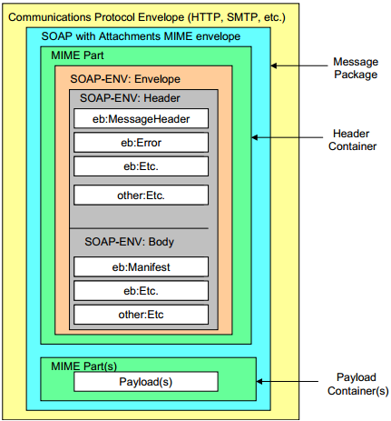
Example: ebXML Message Structure
MIME (Multipurpose Internet Mail Extensions) is a standard that extends the format of email to support:
Text
Non-text attachments
Message bodies with multiple parts
Header information in non-ASCII character sets

Slide 53
WSDL: Web Service Description Language
WSDL is used for describing Web services (interfaces), including four critical aspects of Web services:
Functionality of the services described in standard taxonomy;
Data type of each parameter and the return type of the function (service) call;
Binding information about the transport protocol to be used, usually, SOAP;
Address (URL) for locating the specified service.
The last three aspects can be automatically generated.
Web services described in WSDL can be searched, matched, and discovered based on the requirements.
Web services described in WSDL provides discovery and remote call details.

Slide 54
XML-Based WSDL Document’s Elements
root
<definitions>, service name, namespaces
<Service>
. . .
<Service>
<port>
(URL)
<port>
(URL)
. . .
<binding>
(soap)
<binding>
(soap)
<portType>
<portType>
<operation>
<operation>
<types>
<types>
<message>, in
. . .
<message>, in
<types>
<types>
<message>, out
<message>, out

Slide 55
SOC Services vs. OOC Classes
SOAP/WSDL Services
WSDL interface → Language interface
Namespace of services → Namespace of classes
Service → Class/Object
Operation → Method
Operation type in → Method parameter
Operation type out → Method return value
Binding protocol (SOAP) →
Service address (URL) →
RESTful Services → Resource → Method
Service → Resource → Method

Slide 56
Key SOA, SOC & SOD Concepts
Component-based composition with open standards and protocols
Remote objects, binding, and remote invocation
Autonomous services with platform-independency: Using proxy, instead of code integration
Loosely coupling using message-based communication and asynchronous communication is supported
Web-based repository of internet-searchable and reusable services
Automatic discovering and binding, based on collaboration negotiation, dynamic re-composition, and ontology-based reasoning.
Separation of development: service provider, broker, client

Slide 57
BPEL
Business Process Execution Language (BPEL) is jointly developed by multiple companies
A global model consists of partners and partner links
A flow model defines the workflow
BPEL provides constructs to specify the data and control flows, including:
Assign
Condition
Switch
Loop
etc.

Slide 58
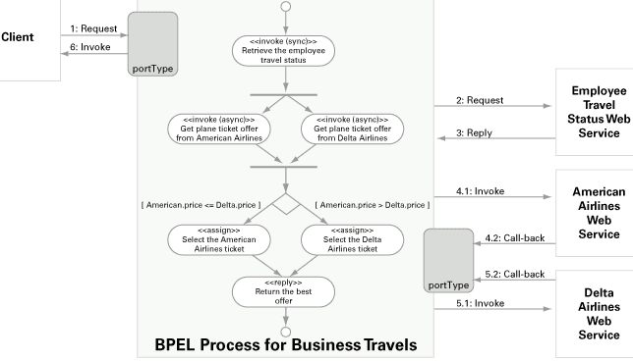
BPEL
Example BPEL process for travel arrangements

Slide 59
Impact of SOA/SOC Paradigm
Explicit differentiation between software engineers and programmers (Three-Party Development Model)
Application builders (software engineers) do not have to focus on programming in the small
Programmers do not have to understand application domain
Tougher but equal competition
Shorter development cycle
Better and more reliable software from specialized providers
Different skill requirements:
Fewer programmers-only jobs may be needed, as reuses increase, automated programming, etc.
More software engineers (CS/CSE/SE graduates) will be needed, as applications increase

Slide 60
Myths and Facts of SOA
Myth | Fact
SOA is a technology. | SOA is a design philosophy independent of any product, technology, or industry trend.
SOAs require Web Services. | SOAs can be realized using Web services, but using Web services will not necessarily result in a SOA.
SOA is new and revolutionary. | EDI (Electronic Data Interchange), CORBA, and DCOM were conceptual examples of SOA.
SOA ensures the alignment of IT and business. | SOA is not a methodology.
A SOA Reference Architecture reduces implementation risk. | SOAs are like snowflakes: No two are the same.
SOA requires a complete technology and business-processes overhaul. | SOA should be incremental and built on your current investments.
SOA requires an army of consultants. | SOA requires tools, not consultants.
We need to build a SOA. | SOA is a means, not an end.

Slide 61
Seven Fallacies of SOA
There's Nothing New Under the Sun, and SOA Is No Exception;
SOA is a Revolutionary Paradigm Shift;
SOAs are All Hype, No Substance;
SOA is a Panacea;
The Overhead from SOA Leads to Unacceptably Poor Performance;
A Bottom-Up Approach to SOA is Good Enough;
SOA is Optional.

Slide 62
How Does SOA Address the DC Fallacies ?
SOA does not have to be Web based. All services could be local! SOA is independent of topology;
platform; and
location.
The network is reliable.
Latency is zero.
Bandwidth is infinite.
The network is secure.
Topology doesn't change.
There is one administrator.
Transport cost is zero.
The network is homogeneous
Race between communication and computing: who wins?
Latency and bandwidth, which one is harder to resolve?
Moore's law: processor power, network speed, and storage size are all increasing exponentially even as their costs drop
SOA uses end-to-end communication
Orchestration (central controlled) versus Choreography (distributed)
This is one of the costs of distribution
SOA is platform independent!

